Slide 1
2-D Arrays
In Java – ICS3U

Slide 2
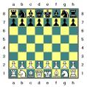
2-D Arrays
A multi-dimensional array is often referred as
An array of arrays
Table
matrix
A multi-dimensional array can be two-dimensional, three dimensional or higher.
We will just focus on 2 D arrays.

Slide 3
2-D Arrays
A two-dimensional array is basically a grid or matrix of items.
It consists of a number of ROWS and COLUMNS.
We could define the layout of a checkboard as a two-dimensional array.
It would be a two-dimensional array declared to be 8 by 8.
*don’t be confused.

Slide 4
Remember
ROW-COLUMN
ROW-COLUMN
ROW-COLUMN
ROW-COLUMN
ROW-COLUMN
ROW-COLUMN
ROW-COLUMN

Slide 5
2-D Arrays Declaration
Declaration
Initialization
Declaration and Initialization Together
These statements would create an array with 3 rows and 4 items in each row.
int [ ] [ ] A;
A = new int [3] [4];
int [ ] [ ] A = new int [3] [4];

Slide 6
Filling an Array During Initialization
If no initializer is provided for an array, then the array is created and automatically filled with the appropriate values depending on the base type of the array.
For numbers the default is zero, false for Boolean, and null for objects.
int [ ] [ ] A = { {6, 7, 4, 3}, {0, 4, 7, 2}, {4, 2, 1, 6} };

Slide 7
Parts of the 2 D Array
Name of Array: A
Type of Array: Int
Number of Rows: 3 (grid location 1 less)
Number of Columns: 4 (grid location 1 less)
Total Storage Locations: 12
int [ ] [ ] A = { {6, 7, 4, 3}, {0, 4, 7, 2}, {4, 2, 1, 6} };
6 | 7 | 4 | 3
0 | 4 | 7 | 2
4 | 2 | 1 | 6

Slide 8
Access Elements
Notice how the coordinates are 1 less then declared
System.out.println(A[2][3]);
0
1
2
3
0
6 | 7 | 4 | 3
0 | 4 | 7 | 2
4 | 2 | 1 | 6
1
2

Slide 9
Putting Values Individually
int [ ] [ ] nums = new int [3] [5];
nums[1][1]= 7
nums[2][1]= 3
nums[0][3]= 5
nums[0][4]= 1
nums[0][0]= nums[1][1]
nums[2][4]= nums[0][3] * 2
What's in the spaces we didn’t fill in??
nums[0][1]= num[1][1]*num[1][4] The answer is: 0 – why?
0
1
2
3
4
0
1
2

Slide 10
Processing Two-Dimensional Arrays
Arrays are usually processed using the for statement.
To process all the items in a two-dimensional array, you will have to use a nested for statements (one for statement, inside another).
One for loop will change the row value and the other for loop will change the column value.

Slide 11
Example
To set all the values in the array equal to 0 you could use the following:
for (int row=0; row <3; row ++) { for (int column=0; column < 4; column ++) { A[row] [column]=0; }//end of 2nd for } //end of 1st for.

Slide 12
Adding Up All Items in the Array
int sum = 0; for (int row=0; row <3; row ++) { for (int column=0; column < 4; column ++) { sum = sum + A[row] [column]; } }

Slide 13
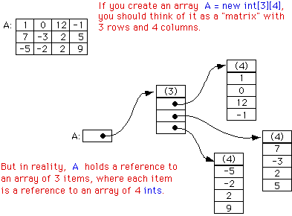
Advanced Concept – Pointers!

Slide 14
Caveats
Don’t let this confuse you – its okay for now to think of a array as a grid.
But its not a rectangular grid. Or maybe think of it as its not exactly 2D in Java.
This has a serious impact on length calls, and the fact that you can initialize arrays that are not perfect columns
as they are really a 1D array – being stored in the sequential array index.

Slide 15
Array.length
Because of this pointer concept, make sure you understand what length your requesting!
Lets examine this code.
public static void main(String[] args) { int[][] myArray= new int[][] { new int[] { 1, 2, 3 }, new int[] { 1, 2, 3, 4}, }; System.out.println(myArray.length); //2 System.out.println(myArray[0].length); //3 System.out.println(myArray[1].length); //4 }

